Slide 1
Spring Cloud
Service Registry
Presenter

Slide 2
Distributed Services Challenges
Service Discovery is one of the key tenets of a microservice based architecture. In distributed systems, dependencies are external services Trying to hand configure each client or use some form of convention can be very difficult to do and can be very brittle. How have we discovered services in the past?
Service Locators
Dependency Injection
Service Registries
Notes:
Service Discovery is one of the key tenets of a microservice based architecture.
In distributed systems, application dependencies cease to be a method call away.
Trying to hand configure each client or use some form of convention can be very difficult to do and can be very brittle.

Slide 3
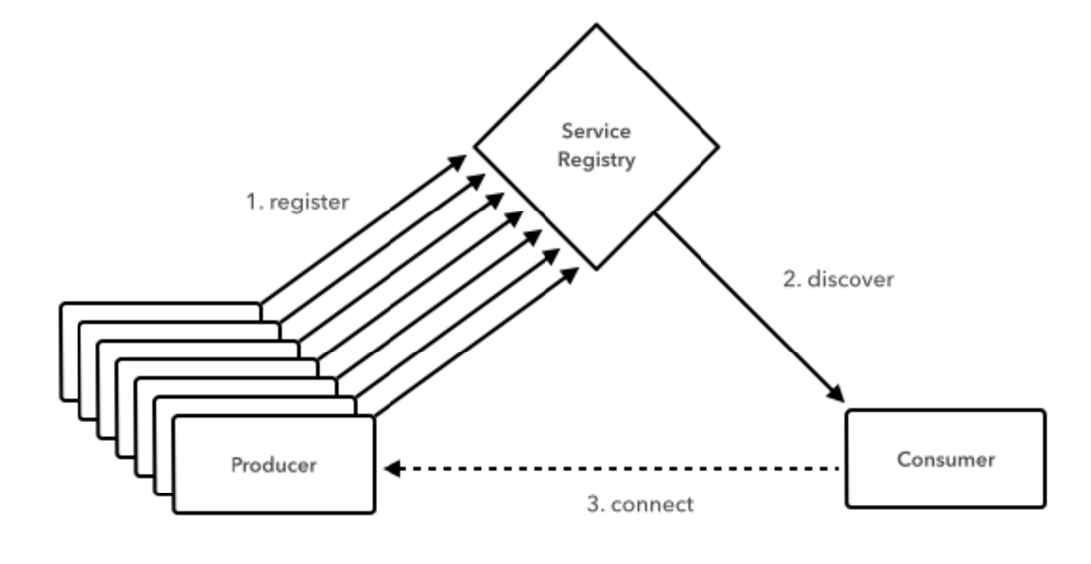
Spring Cloud Config
Notes:
Service instances in the registry all have to send heartbeats to keep their registrations up to date
Clients also have an in-memory cache of eureka registrations (so they don’t have to go to the registry for every single request to a service)

Slide 4
Spring Cloud Service Registry
Provides an HTTP interface + client libs for client registry/discovery Registry server collects heartbeats, maintains registry of available services/instances, exchanges registries with local peers + other “zones” Registry contains detailed information about each service
Service name, Host & port of each instance
Health indicator, URLs (health, homepage, etc)
Embeddable easily in a Spring Boot application using @EnableEurekaServer and @EnableDiscoveryClient
Notes:
Service Discovery is one of the key tenets of a microservice based architecture.
In distributed systems, application dependencies cease to be a method call away.
Trying to hand configure each client or use some form of convention can be very difficult to do and can be very brittle.

Slide 5
Service Registry – Availability Zones
West ‘Zone’
East ‘Zone’
Exchange
Service Registry
Service Registry
Discover
Register
Register
Client
✗✗✗
Client
Connect
✗✗✗
Service
Service
Notes:
Service instances in the registry all have to send heartbeats to keep their registrations up to date
Clients also have an in-memory cache of eureka registrations (so they don’t have to go to the registry for every single request to a service)

Slide 6
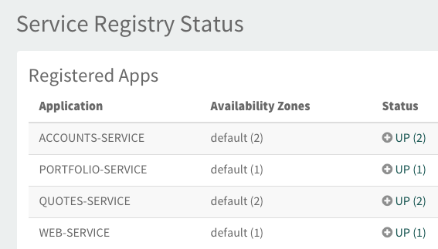
Client Service Discovery
@SpringBootApplication
@EnableDiscoveryClient
public class MyClientApp{
public static void main(String[] args) {
SpringApplication.run(MyClientApp.class, args);
}
}
public Portfolio accountLookup(String acctId) {
Portfolio p = restTemplate.getForObject(
“http://portfolio-service/portfolio/{accId}”,
Portfolio.class
acctId);
return p;
}
Notes:
The server is easily embeddable in a Spring Boot application using the@EnableConfigServer annotation.
Application configuration data is stored in a backend
Git, Subversion and File System backends are supported
Git is the default backend. It's great for auditing changes and managing upgrades
Setting the git backend is done via the spring.cloud.config.server.git.uriconfiguration property

Slide 7
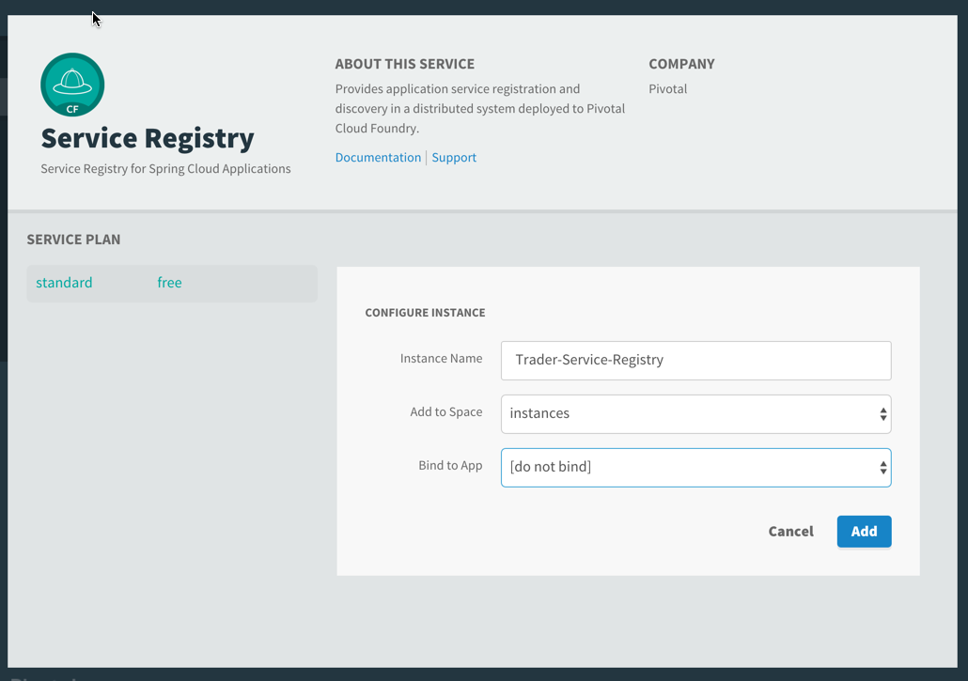
Spring Cloud Services: Service Registry
Automated deployment of server component Security-optimized Eureka service instance using Oauth2 Bind into CF client application(s) Cloud Connectors for auto-reconfiguration

Slide 8
Spring Cloud: Client-side Load Balancing
Eureka only provides registry + discovery Ribbon is a client side LB providing control over the behavior of HTTP and TCP clients
Pick right LB algorithm for client application + extensible algorithms
At least 1 less hop for client requests
Cloud-aware patterns (zones, circuit breakers, etc.)
No additional setup, just deploy apps
Spring Cloud Gateway is a reactive JVM-based router and proxy commonly paired with Ribbon to create API gateways and reverse proxies

Slide 9
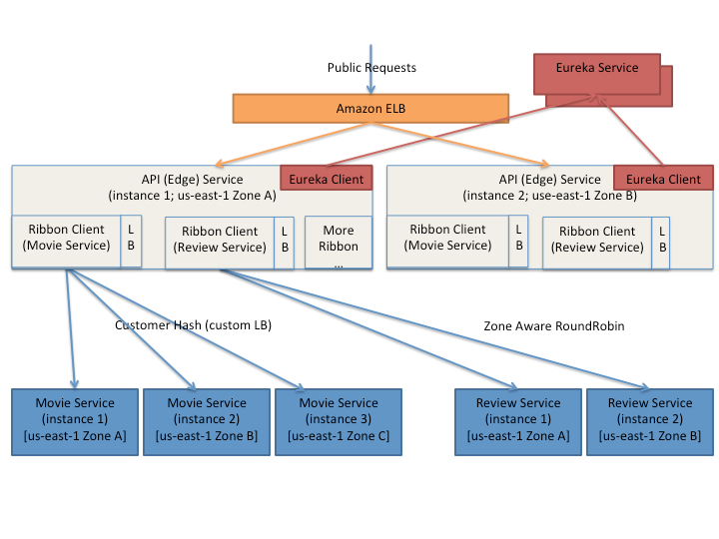
Microservice API Gateways
Netflix uses Zuul and Ribbon for
Authentication
Stress Testing
Canary Testing
Dynamic Routing
Service Migration
Load Shedding
Security
Static Response handling
Active/Active management

Slide 10
Demo

Slide 11

Transforming How The World Builds Software
© Copyright 2017 Pivotal Software, Inc. All rights Reserved.

